Slide 1
Born-Again and Bayesian approaches for improving trees
Marjolein Fokkema
Leiden University
IFCS 2022
m.fokkema@fsw.leidenuniv.nl

Slide 2

Trees
Good: Easy to interpret and apply
Bad: Not most accurate method
Ugly: Unstable
Notes:
This conondrum is the topic of my presentation.
PUT THE DIFFERENT TREES HERE, after ugly: unstable, before picture.
Spaghetti Western, 1966, Sergio Leone

Slide 3
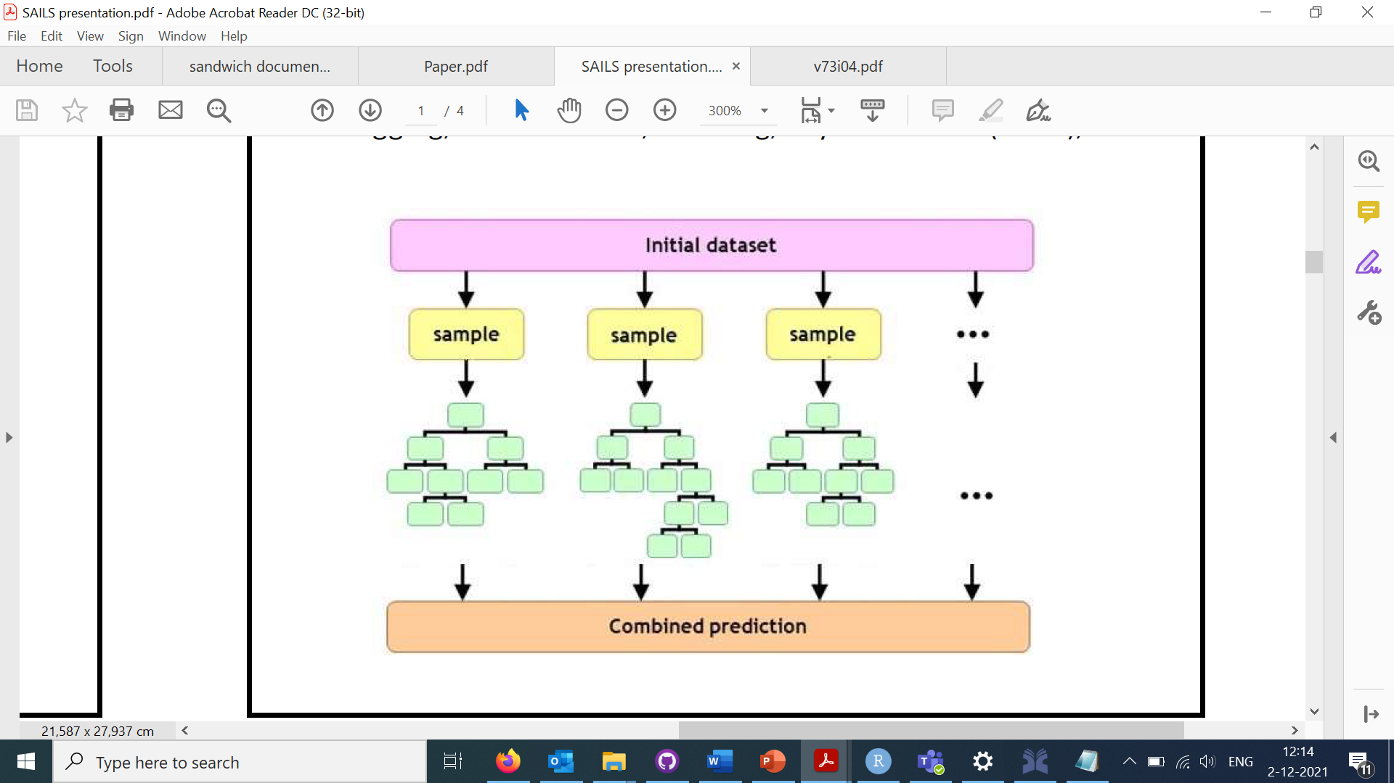
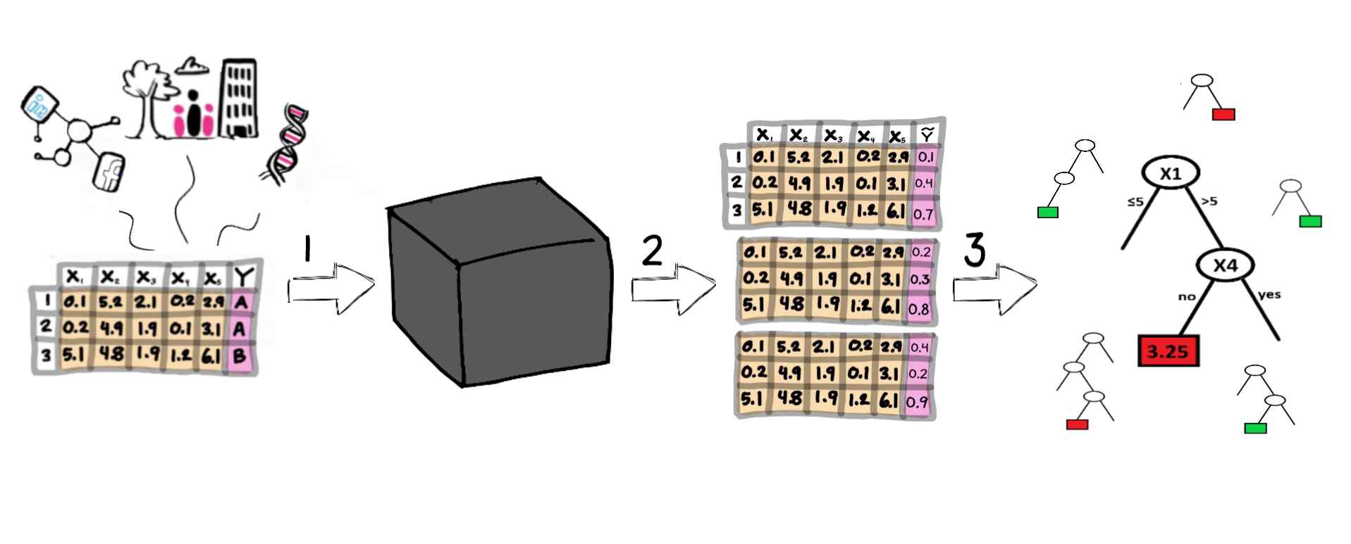
Tree ensembles
Random forests
Gradient boosting
Bayesian additive regression trees
…..

Slide 4
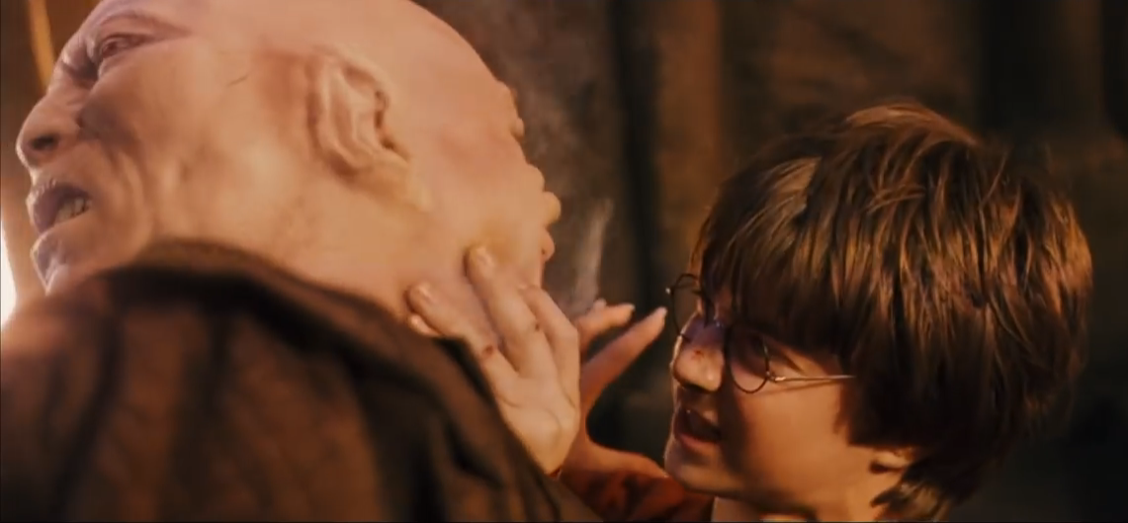

Good: Interpretability
Good: High $N$, low $σ_{ε}$

Slide 5
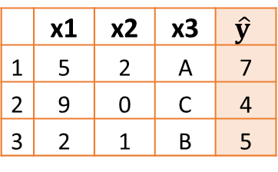
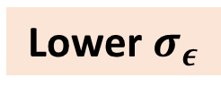
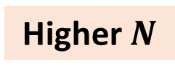
Manufacturing data
 | x1 | x2 | x3 | y
1 | 5 | 2 | A | 8
2 | 9 | 0 | C | 3
3 | 2 | 1 | B | 6
Higher $N$
Lower $σ_{ε}$
 | x1 | x2 | x3 | $$\hat{y}$$
1 | 5 | 2 | A | 7
2 | 9 | 0 | C | 4
3 | 2 | 1 | B | 5
1 | 5 | 2 | A | 7
2 | 9 | 0 | C | 4
3 | 2 | 1 | B | 5

Slide 6
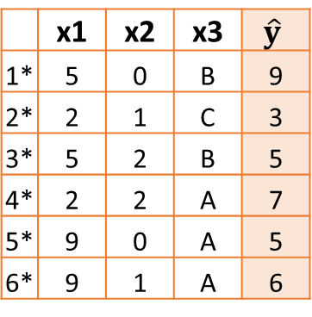
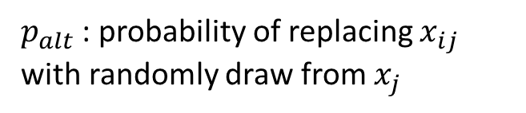
Born-again approach (Breiman & Shang, 1996)
 | x1 | x2 | x3 | y
1 | 5 | 2 | A | 8
2 | 9 | 0 | C | 3
3 | 2 | 1 | B | 6
Resample from X and permute
E(Y|X)
 | x1 | x2 | x3 | $$\hat{y}$$
1* | 5 | 0 | B | 9
2* | 2 | 1 | C | 3
3* | 5 | 2 | B | 5
4* | 2 | 2 | A | 7
5* | 9 | 0 | A | 5
6* | 9 | 1 | A | 6
$p_{alt}$ : probability of replacing $x_{ij}$ with randomly draw from $x_{j}$

Slide 7

“Bayesian” approach (author)
 | x1 | x2 | x3 | y
1 | 5 | 2 | A | 8
2 | 9 | 0 | C | 3
3 | 2 | 1 | B | 6
Resample from X
Draw from posterior
 | x1 | x2 | x3 | $$\hat{y}$$
1 | 5 | 2 | A | 8
2 | 9 | 0 | C | 3
3 | 2 | 1 | B | 5
1 | 5 | 2 | A | 7
2 | 9 | 0 | C | 4
3 | 2 | 1 | B | 6

Slide 8
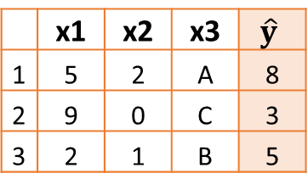
Simplistic approach (author)
 | x1 | x2 | x3 | y
1 | 5 | 2 | A | 8
2 | 9 | 0 | C | 3
3 | 2 | 1 | B | 6
Copy X
E(Y|X)
 | x1 | x2 | x3 | $$\hat{y}$$
1 | 5 | 2 | A | 8
2 | 9 | 0 | C | 3
3 | 2 | 1 | B | 5

Slide 9
Experiment
Classification datasets
Breast Cancer
Ionosphere
Sonar
Regression datasets
Boston Housing
Ozone
Friedman non-linear #1, #2, #3
Tree: GLM trees (Zeileis et al., 2008)
Black box: Bayesian Additive Regression Trees (Chipman et al., 2010)
Weights used to mitigate effect of inflated sample size
Performance evaluated by repeated cross validation
Real datasets: 10-fold CV
Simulated data: 200 training, 2,000 test observations

Slide 10
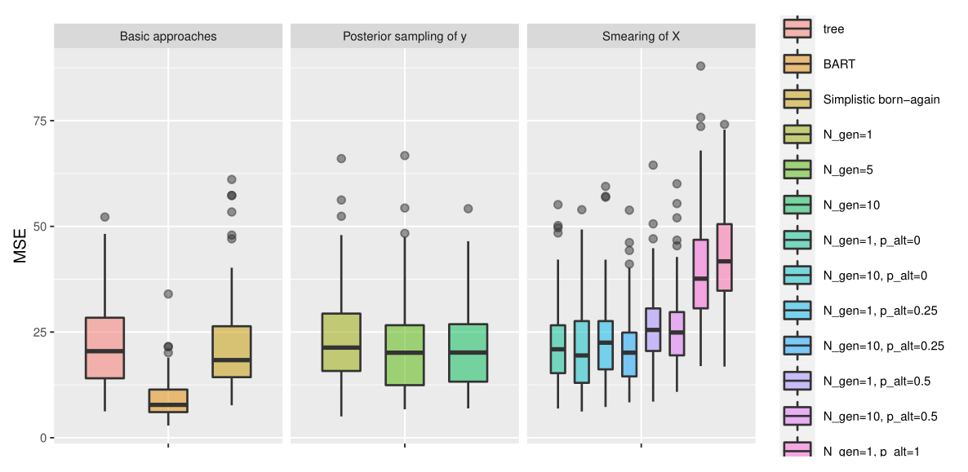
Boston Housing

Slide 11
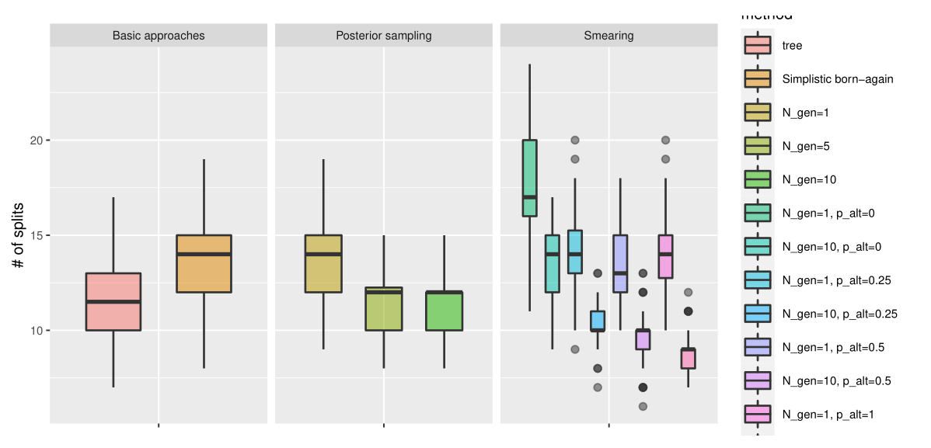
Boston Housing

Slide 12
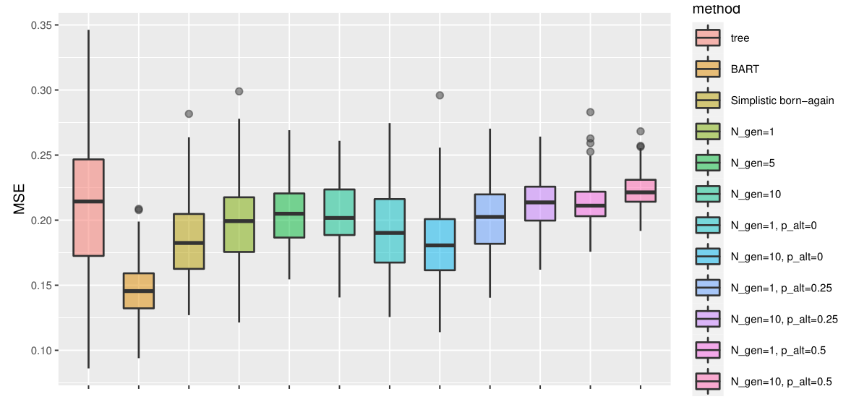
Sonar
Mean squared loss on predicted probabilities

Slide 13
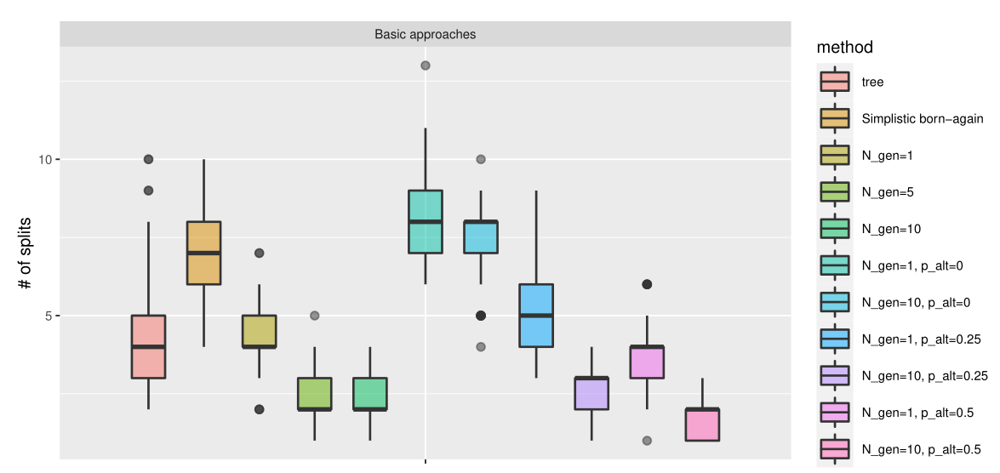
Sonar

Slide 14
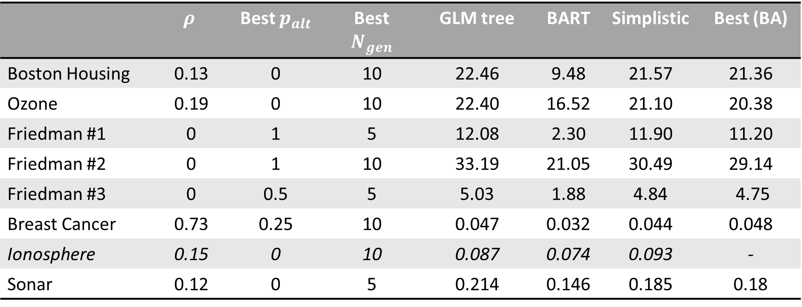
Results: Overview
 | $$ρ$$ | Best $p_{alt}$ | Best $N_{gen}$ | GLM tree | BART | Simplistic | Best (BA)
Boston Housing | 0.13 | 0 | 10 | 22.46 | 9.48 | 21.57 | 21.36
Ozone | 0.19 | 0 | 10 | 22.40 | 16.52 | 21.10 | 20.38
Friedman #1 | 0 | 1 | 5 | 12.08 | 2.30 | 11.90 | 11.20
Friedman #2 | 0 | 1 | 10 | 33.19 | 21.05 | 30.49 | 29.14
Friedman #3 | 0 | 0.5 | 5 | 5.03 | 1.88 | 4.84 | 4.75
Breast Cancer | 0.73 | 0.25 | 10 | 0.047 | 0.032 | 0.044 | 0.048
Ionosphere | 0.15 | 0 | 10 | 0.087 | 0.074 | 0.093 | -
Sonar | 0.12 | 0 | 5 | 0.214 | 0.146 | 0.185 | 0.18

Slide 15
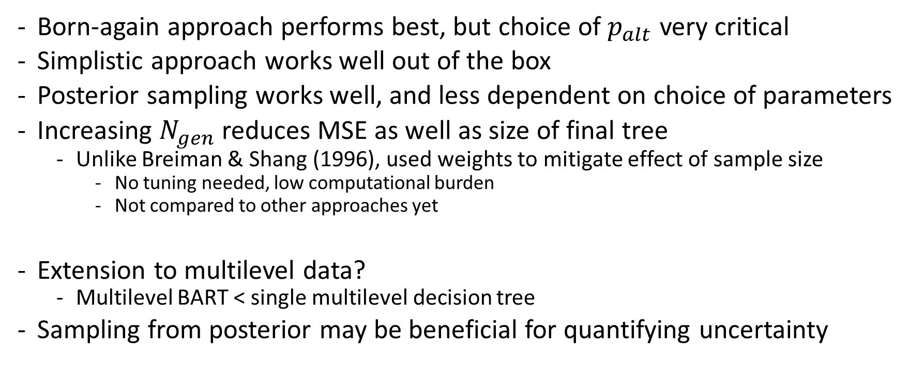
Discussion
Born-again approach performs best, but choice of $p_{alt}$ very critical
Simplistic approach works well out of the box
Posterior sampling works well, and less dependent on choice of parameters
Increasing $N_{gen}$ reduces MSE as well as size of final tree
Unlike Breiman & Shang (1996), used weights to mitigate effect of sample size
No tuning needed, low computational burden
Not compared to other approaches yet
Extension to multilevel data?
Multilevel BART < single multilevel decision tree
Sampling from posterior may be beneficial for quantifying uncertainty

Slide 16
References
Breiman, L., & Shang, N. (1996). Born again trees. University of California, Berkeley, Berkeley, CA, Technical Report, 1(2), 4.
Chipman, H. A., George, E. I., & McCulloch, R. E. (2010). BART: Bayesian additive regression trees. The Annals of Applied Statistics, 4(1), 266-298.
Markovitch, B., & Fokkema, M. (2021). Improved prediction rule ensembling through model-based data generation. arXiv preprint arXiv:2109.13672. https://arxiv.org/abs/2109.13672
Zeileis, Achim, Torsten Hothorn, and Kurt Hornik. Model-based recursive partitioning. Journal of Computational and Graphical Statistics 17.2 (2008): 492-514.

Slide 18
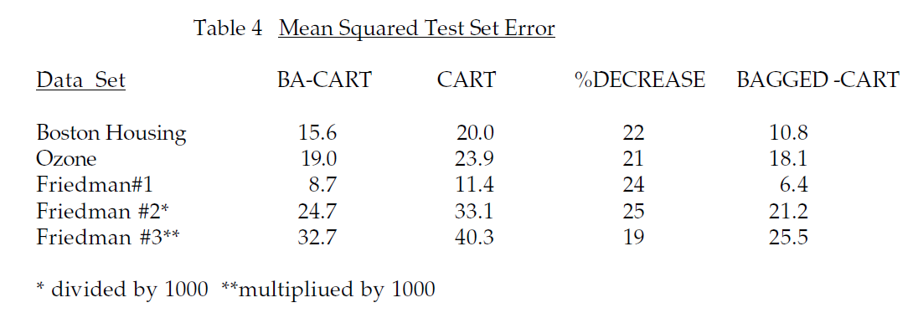

Slide 19
